Slide 1
Bionic Mechanical Goose Based on Water Surface SLAM Mapping
------GOOBOT Project

Slide 2
Target & Anticipation
A bionic robot : precise control & autonomous driving
--- Physical structure : float on the water
--- Movement control : precise control of posture & movement
--- Route planning : identity the environment
Harmoniously blend into the natural surroundings
--- mini-robot、less noise、 bionic appearance
--- interactive : interact with the environment and human
Other bionic structure or mechanical structure

Slide 3
SLAM
PID Control
Communication problems of each module
Physical structure design
Electrical system design
Preliminary investigation
Current work
Sensors and control board
Mechanical structure

Slide 4

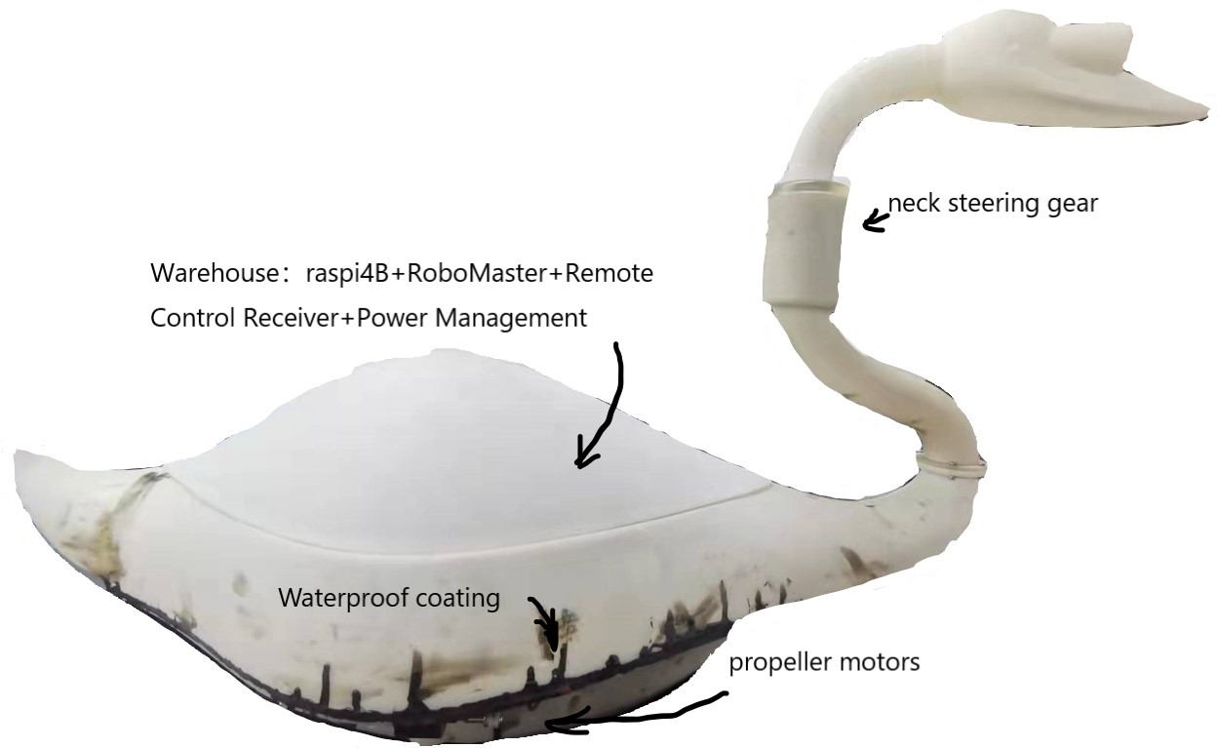
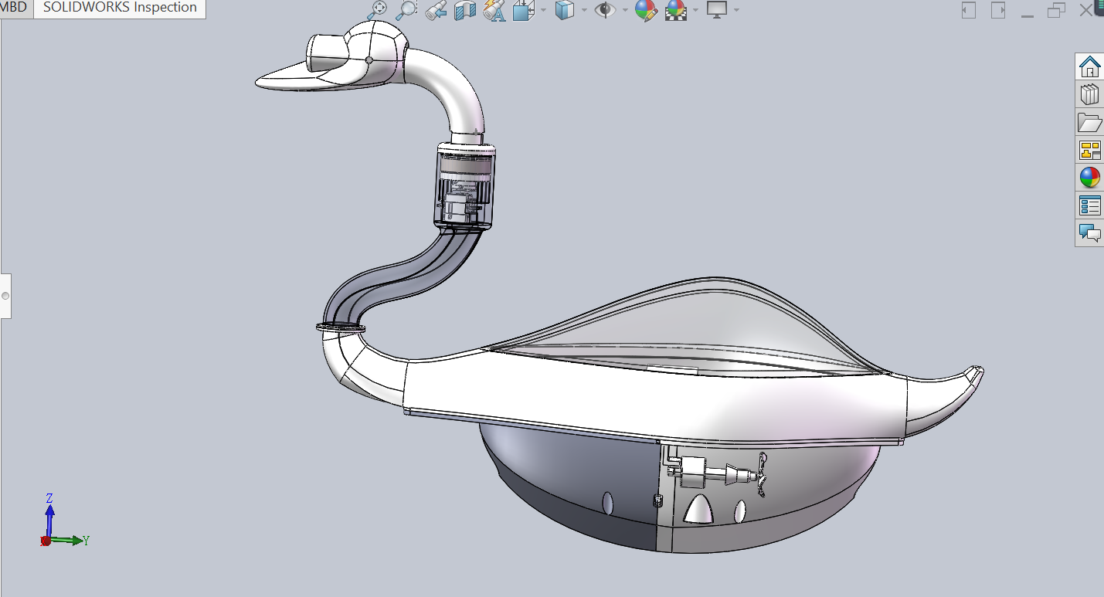
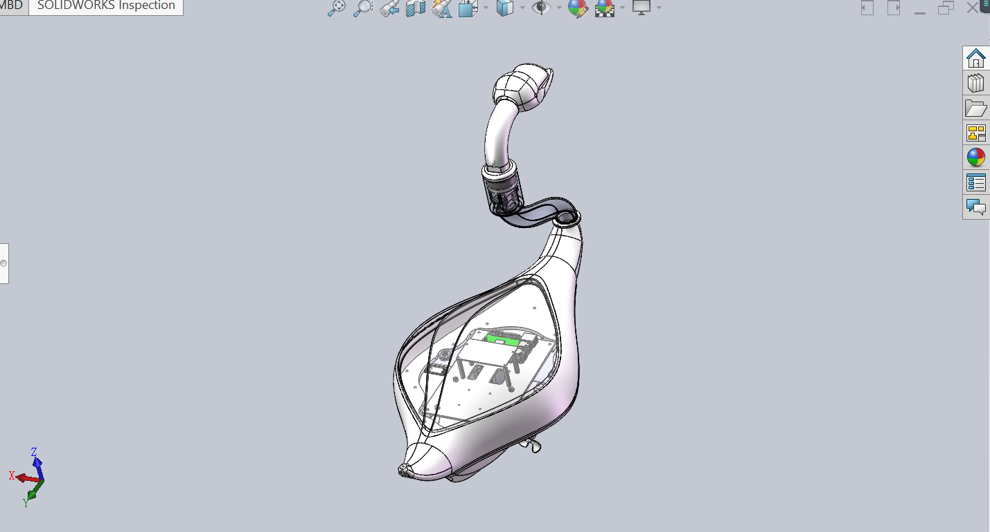
Camera

Slide 5
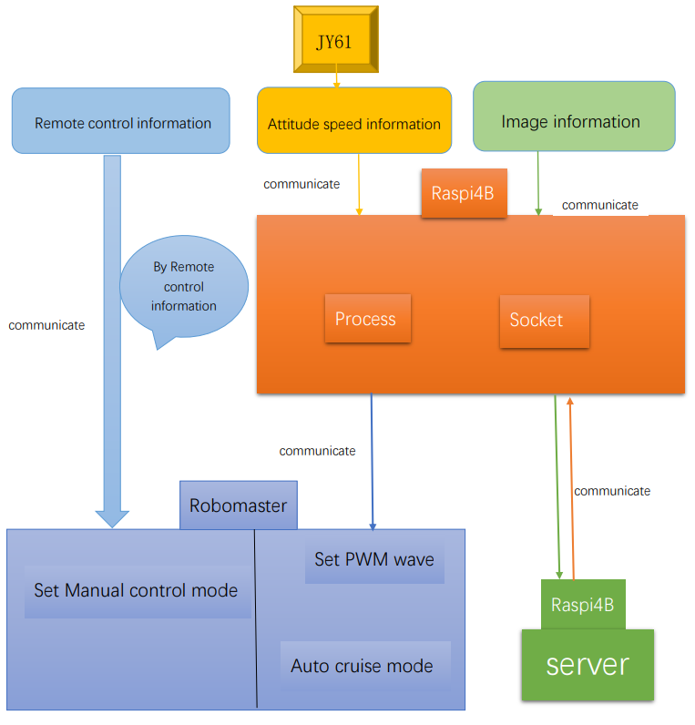
Current work
Current work

Slide 6
Work
Hardware debug、 Hardware debug、 Hardware debug……
Hardware design and test.
Achieve the communication between Raspberry and Robomaster.
Initialize the propeller motors. Initialize the ESC named “Haotiao”.
Achieve the communication between Robomaster and motors. (configure the environment)
Get the posture parameters. ( unachievable: stabilizing z-axis deviation with geocentric acceleration )
Raspberry related work

Slide 7
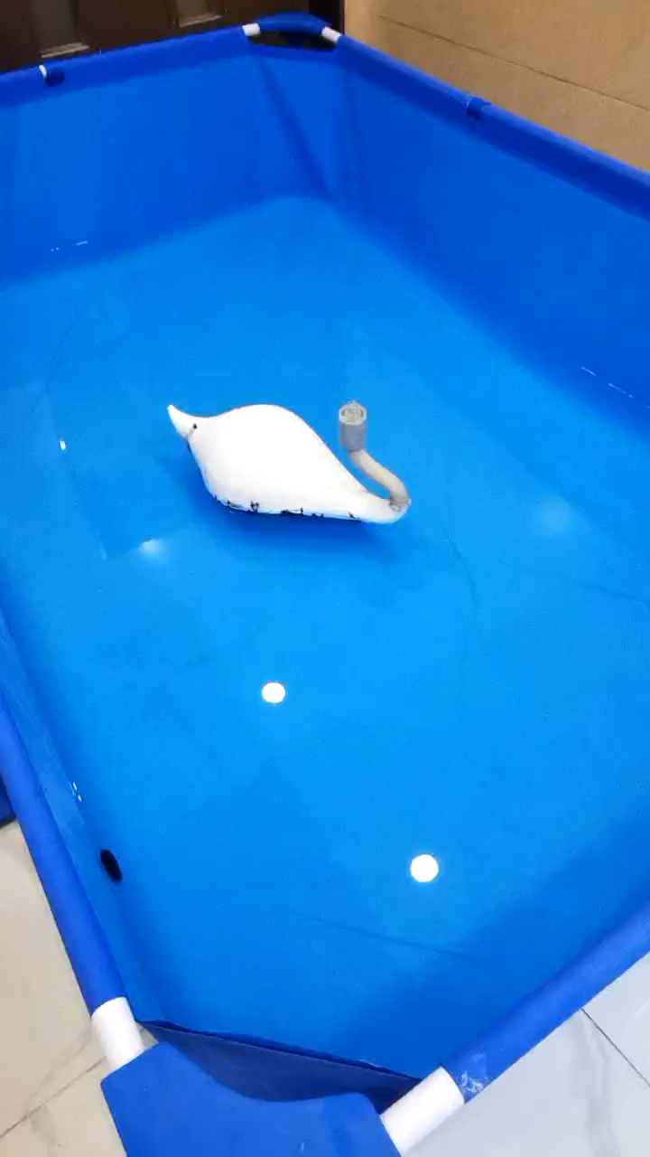
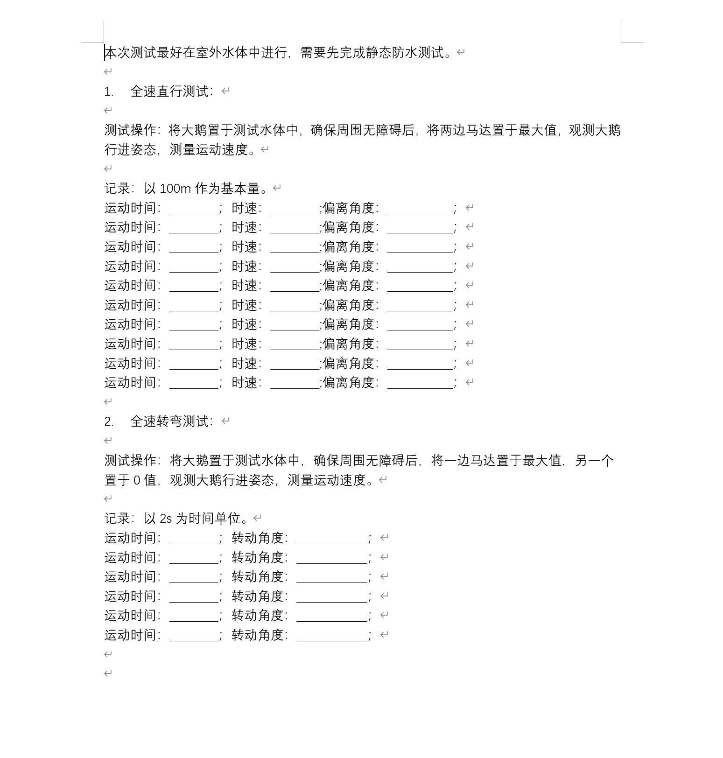
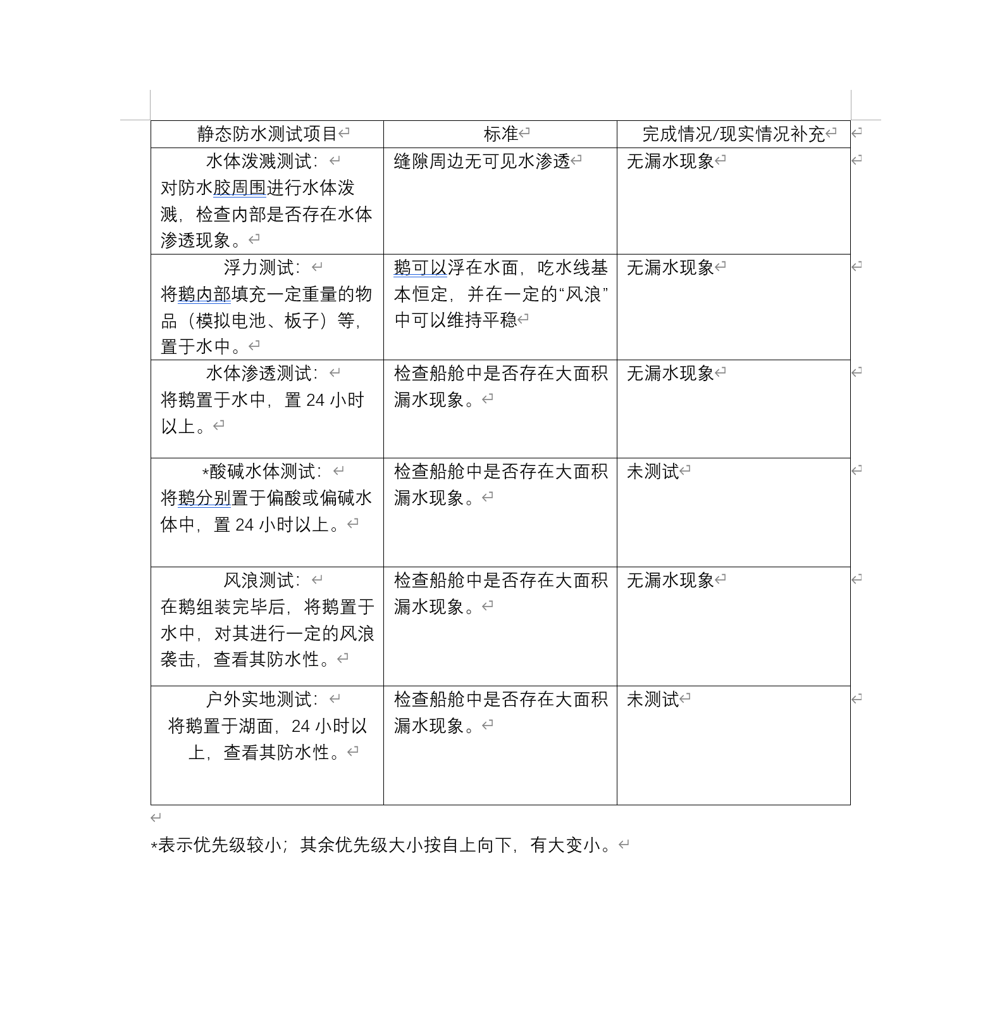

Slide 8
SLAM
Simultaneous Localization and Mapping
Can I use the camera to complete the slam ?
Why I need mapping function ?
Autonomous cruise need a map
Initializing mapping in unknown waters is important
Picking up rubbish needs to locate rubbish location
There is no mature technology in this area

Slide 9
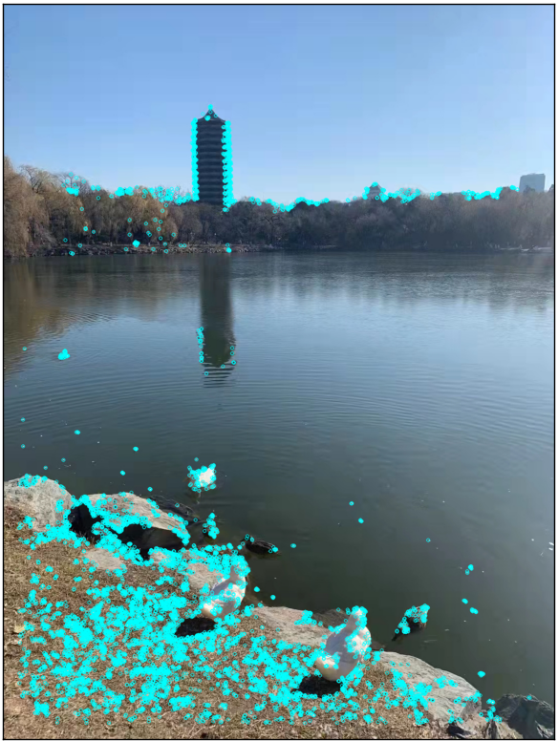
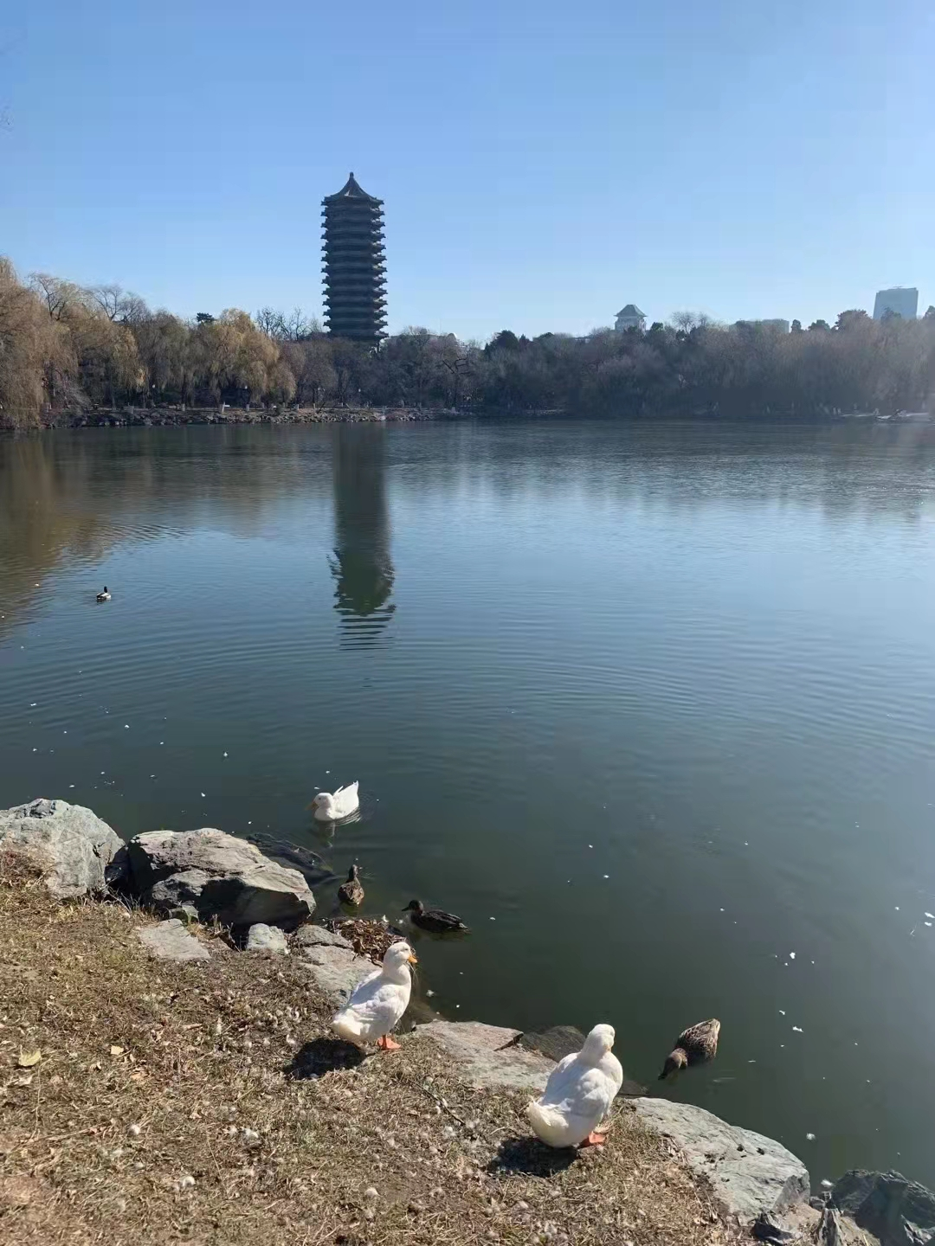
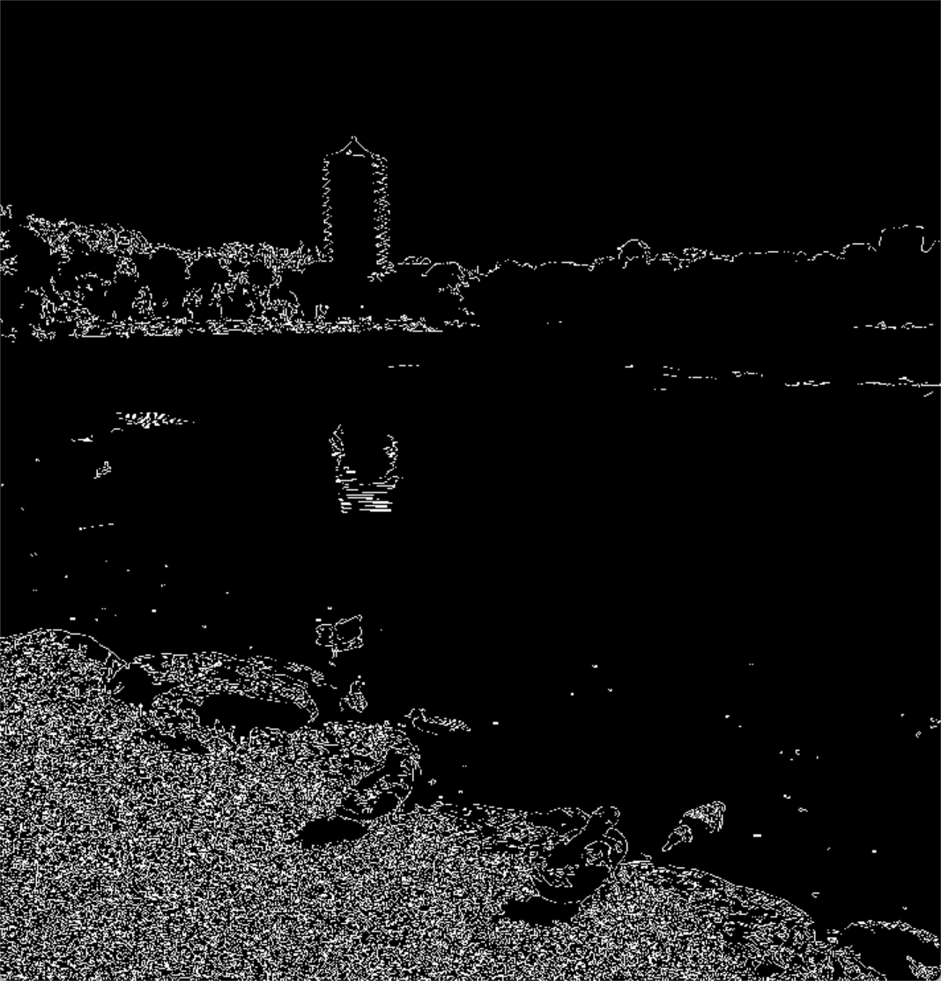
difficulty
ORB
Few points
Canny
Reflection

Slide 10
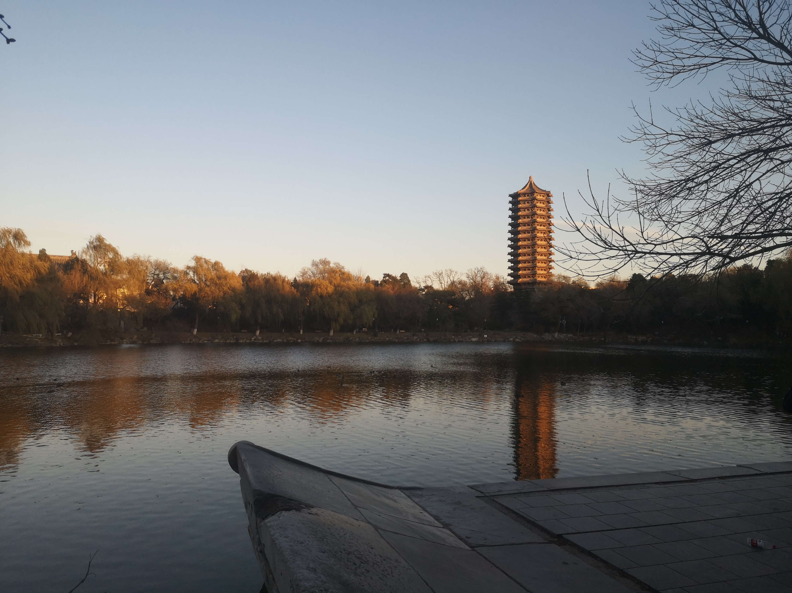
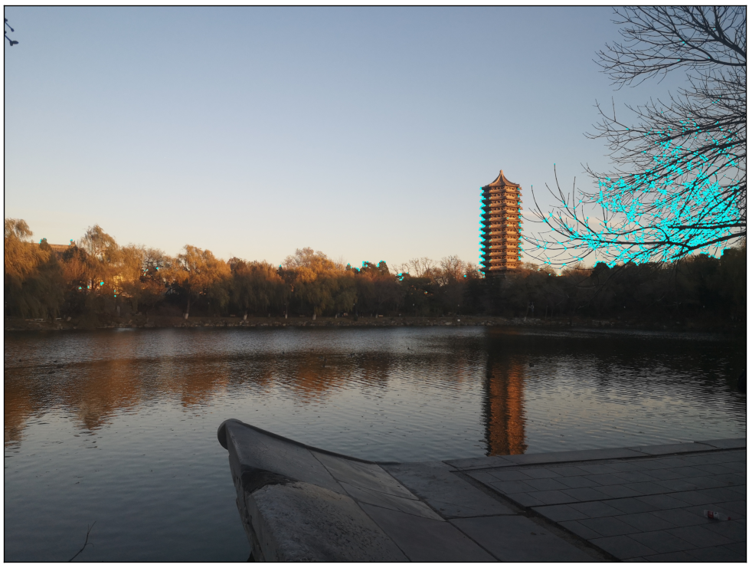
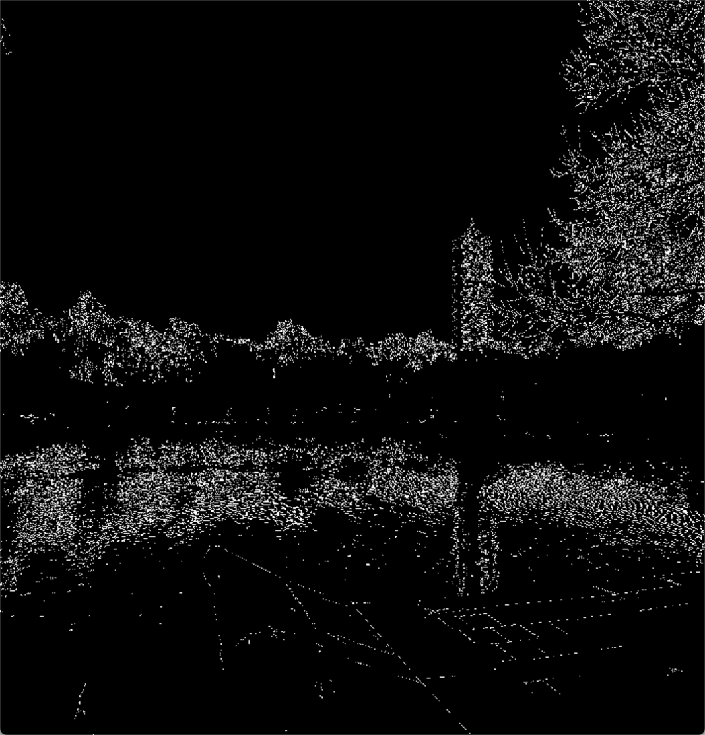
Few points
Water ripples will cause greater interference in the extraction of image edge points
The number of corner points will be wasted in the environment on the bank
ripple

Slide 11
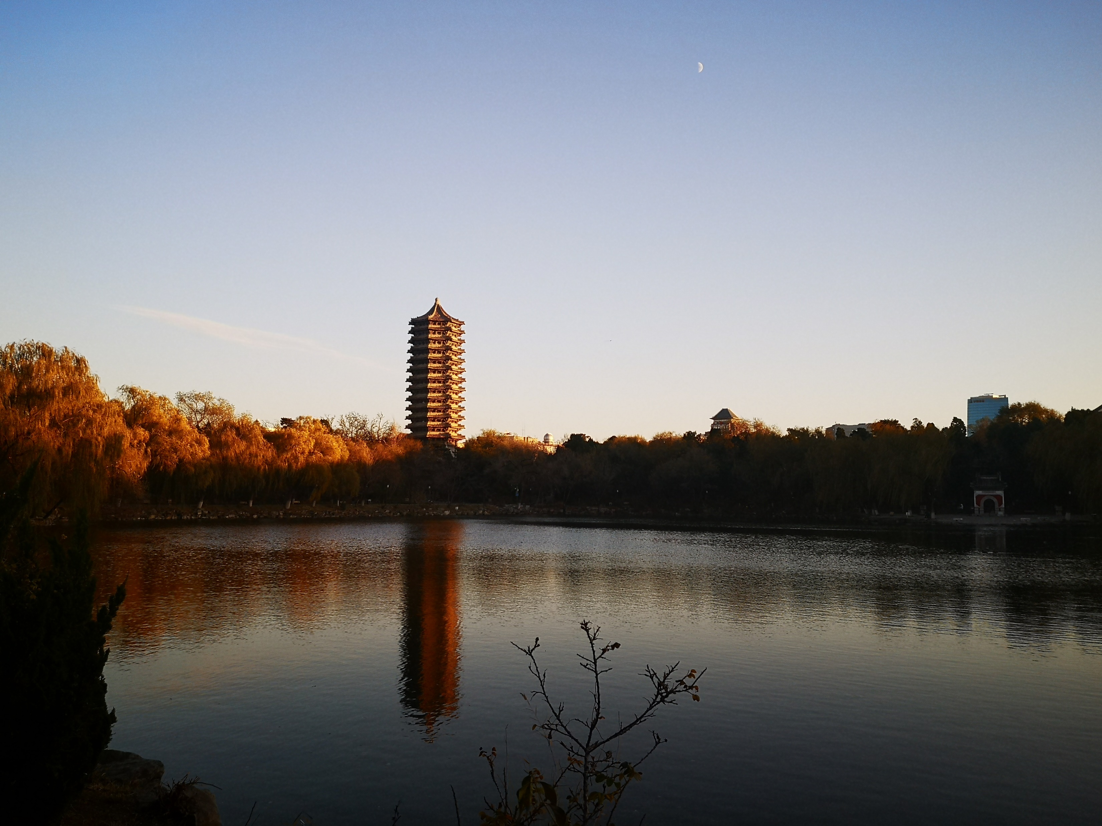
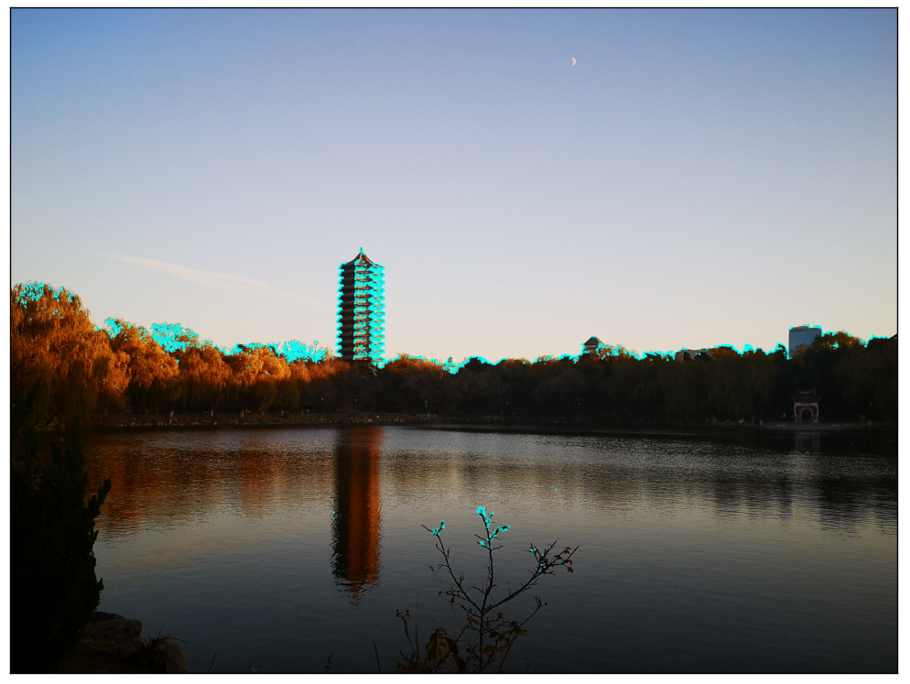
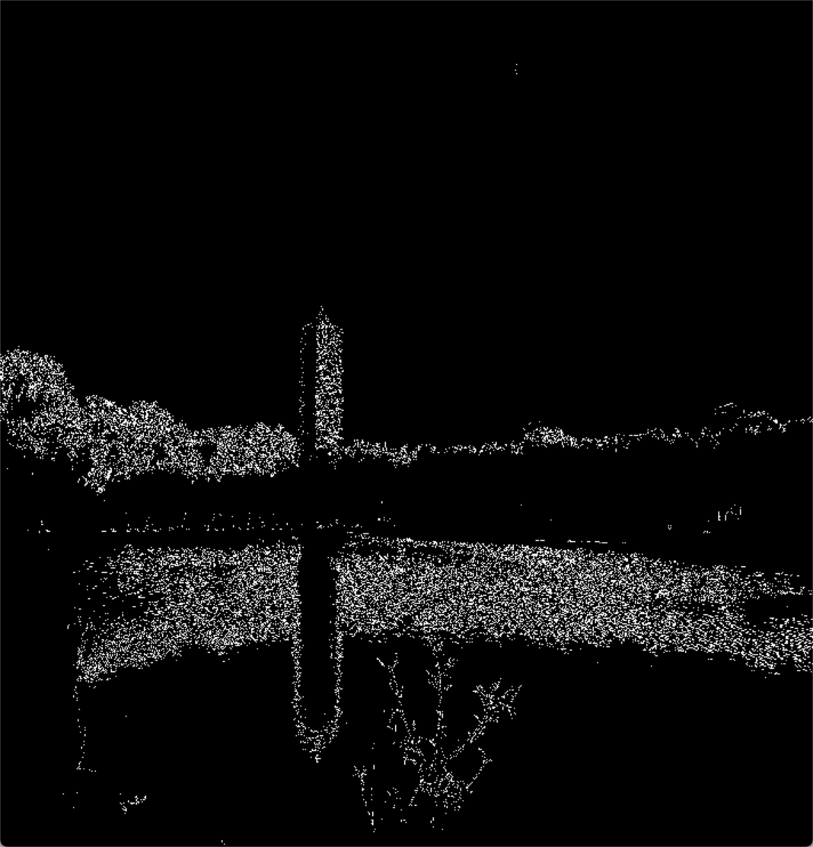
Reflection + ripples
poor

Slide 12
Which SLAM should choose/create ? (Goals for the next stage)
ORB-SLAM2 ?
May get sparse feature points, the final effect is poor
Active SLAM ?
Increase cruise action, low efficiency
Not be suitable for dynamic systems like water surface
------------------------------
Efficient、Good performance、 suitable for dynamic systems

Slide 13
Next step
Launch test !
Get data from experiments to optimize PID control
Get pictures from Goose perspective to help SLAM work

Slide 14
Thank you

